Slide 1
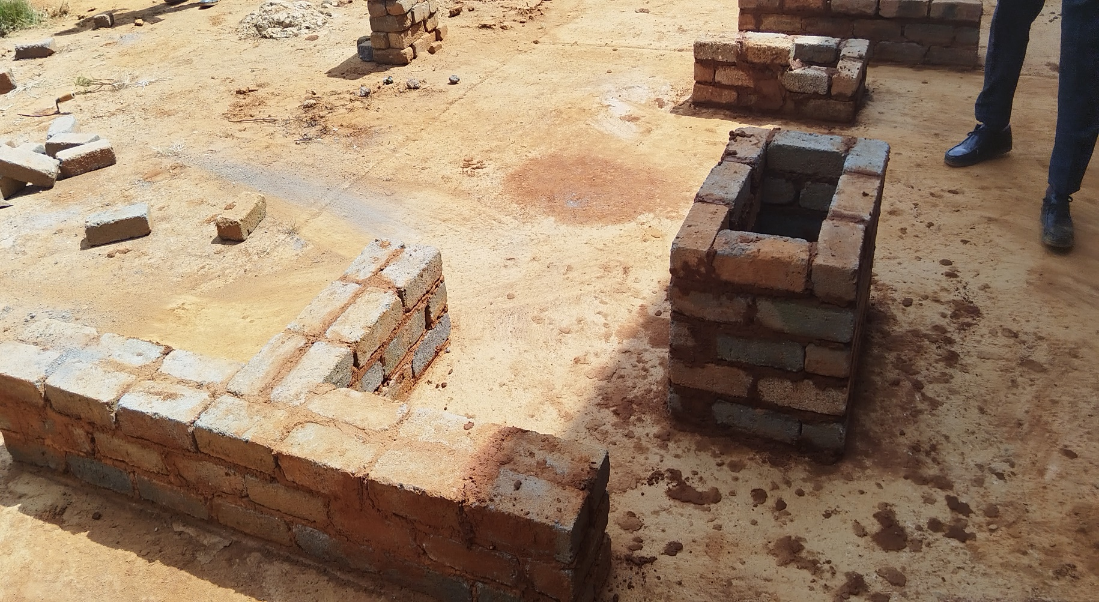
Building and Plastering Maintenance
Video : Introduction to Building and Plastering
https://youtu.be/QwYQiUirI5w?si=kxRYexzA_o0jdeX9

Slide 2
Building and Plastering Maintenance
Safety Rules
1. Always wear personal protective equipment (PPE).
2. Be mindful and follow signs.
3. Provide clear instructions.
4. Keep site clean.
5. Organize and store tools properly.
6. Use the right tools or equipments for the right task.
7. Have an emergency response plan.
8. Set up barriers, fences and safeguards.
9. Do pre-checks on tools and equipments
10. Report issues immediately.
Video : https://youtu.be/YLH-Ih8omjI?si=nerKxhByGiuRNnj7
Feedback : Activity

Slide 3
Kwa Thema Skills School
Subject : Maintenance Marks : 10
Grade : Year 1 Time : 30 mins
Date : / / 2024
Question : 1
1.Fill in the following sentences.
1.1 _____________ issues immediately.
1.2 Always wear __________________ protective equipment.
1.3 Set up barriers, fences and ____________________ .
1.4 Provide ______________ instructions.
1.5 Use the right ______________ or equipments for the right task.
1.6 _________________ and store tools properly.
1.7 Keep _______________ clean.
1.8 Have an ___________________ response plan.
1.9 Be mindful and follow ________________.
1.10 Do __________________ on tools and equipments.
( signs; report; pre-checks; clear; tools; site ; organize; emergency; safeguards; personal)

